Slide 1
Finger Lakes Nurse Honor Guard Ruth Benjamin RN,GERO-BC,CRRN,CDDN,CHPN Founder and President of FLNHG

Slide 2
Our Mission
The Finger Lakes Nurse Honor Guard is privileged to recognize and honor those who have dedicated their lives to serving others in their chosen profession as a nurse during the last seaso of their life and/or at the end of their life journey.
The honor guard's presence provides meaningful recognition and honor to a nurse that has passed and in hopes of easing the grief of their family members, loved ones and colleagues.

Slide 3
Who is Eligible to be Honored by the Nurse Honor Guard?
Any active or retired licensed practical nurse, registered nurse, or nurse practitioner when asked to do so by family.
This might happen through direct
contact with known family
Through funeral home director or
clergy
As a result of reviewing area
obituaries and contacting the
appropriate people

Slide 4
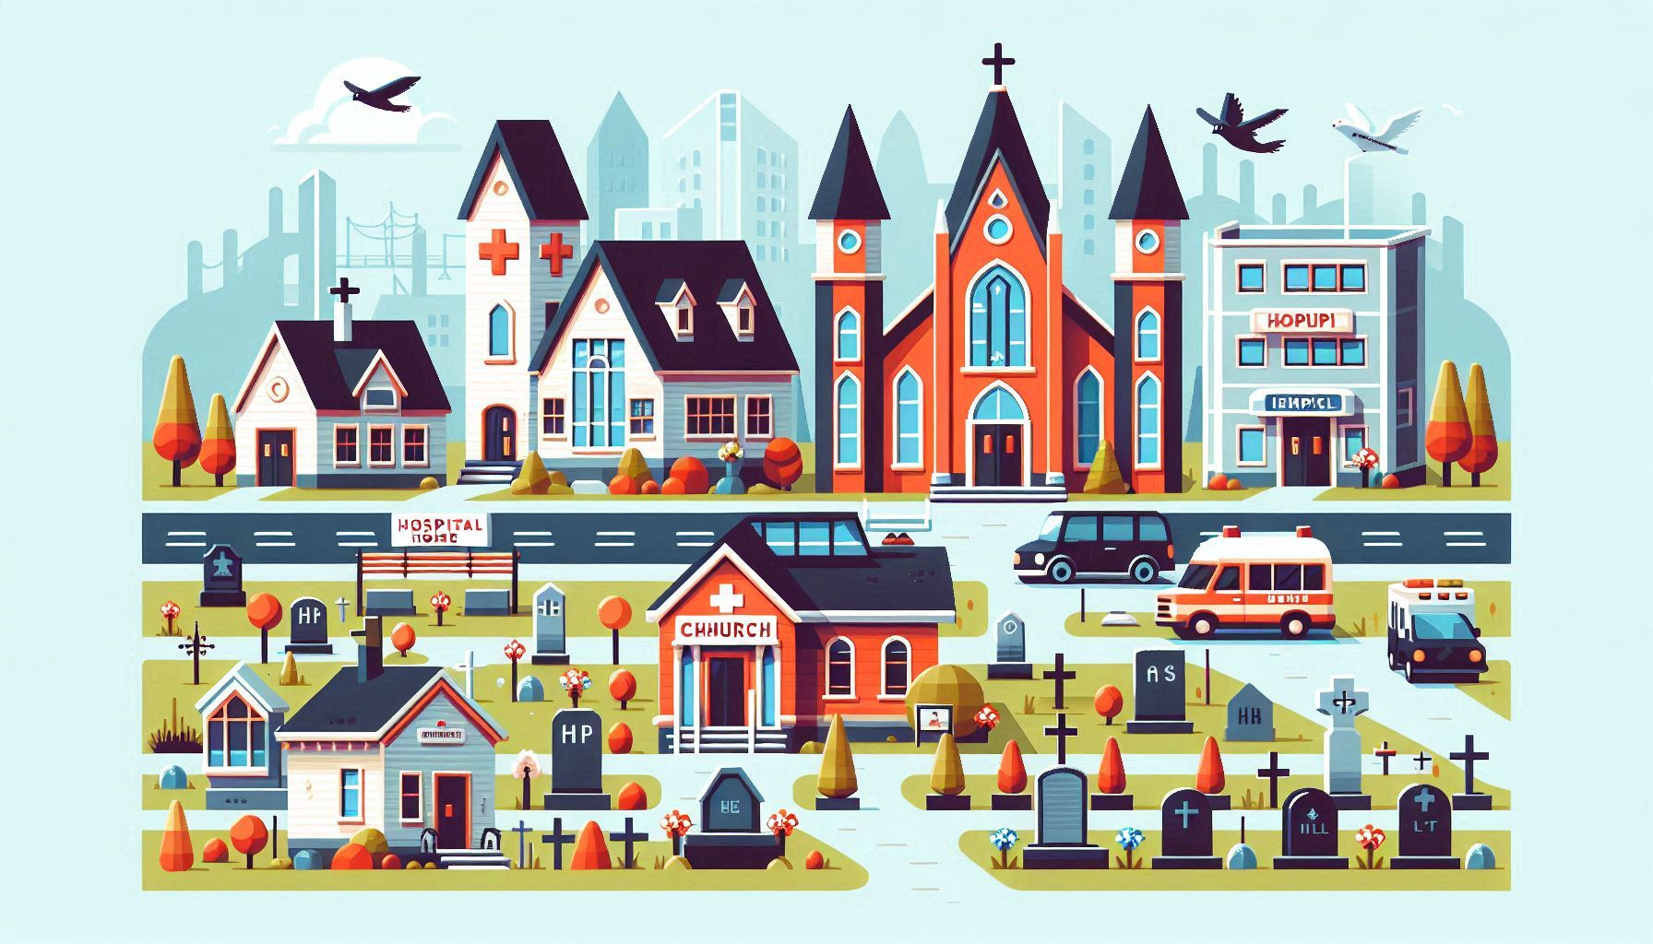
Tribute Ceremonies Can be held in Several Locations
Memorial Service
Funeral Home
Gravesite
Church or place of worship

Slide 5
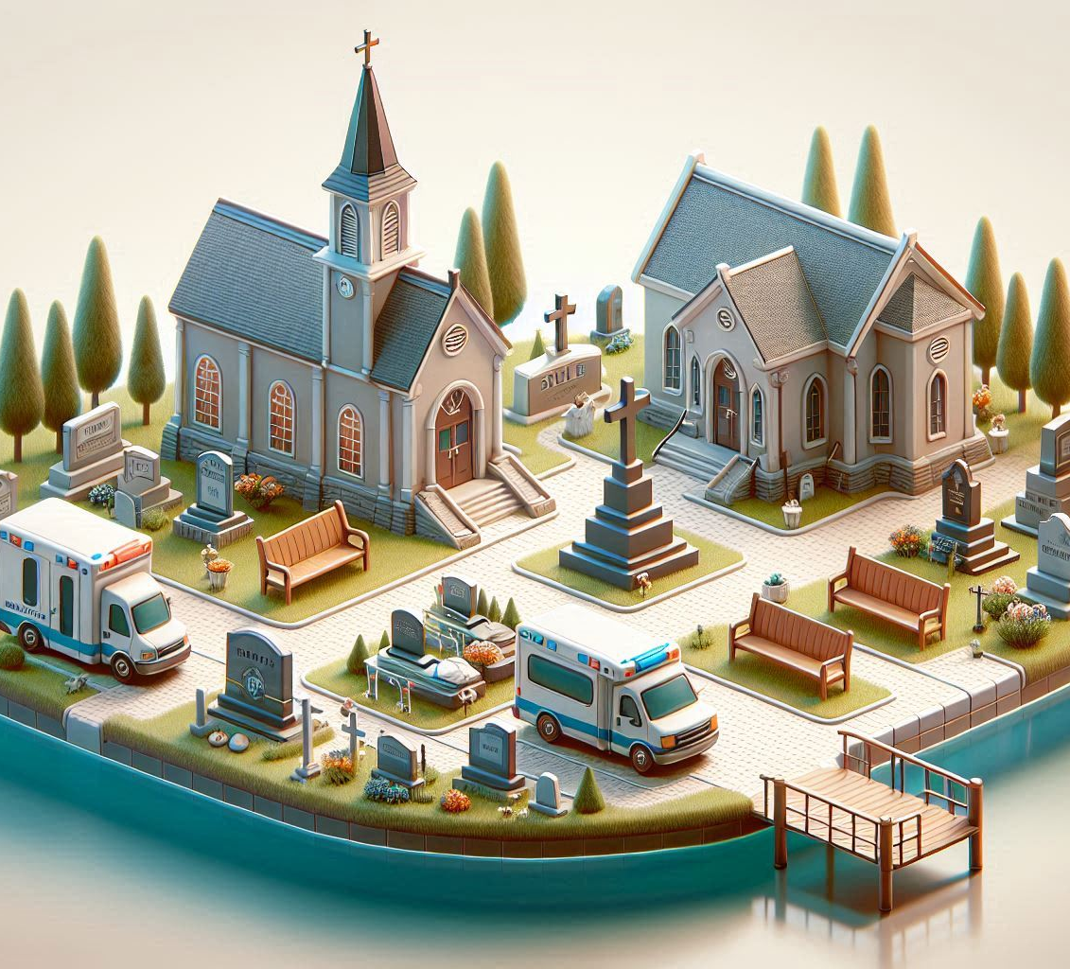
LivING Tributes
A living tribute can be done for a nurse who is elderly, medically frail, or receiving hospice services
Nursing home setting
Hospital setting
Hospice setting
Home setting

Slide 6
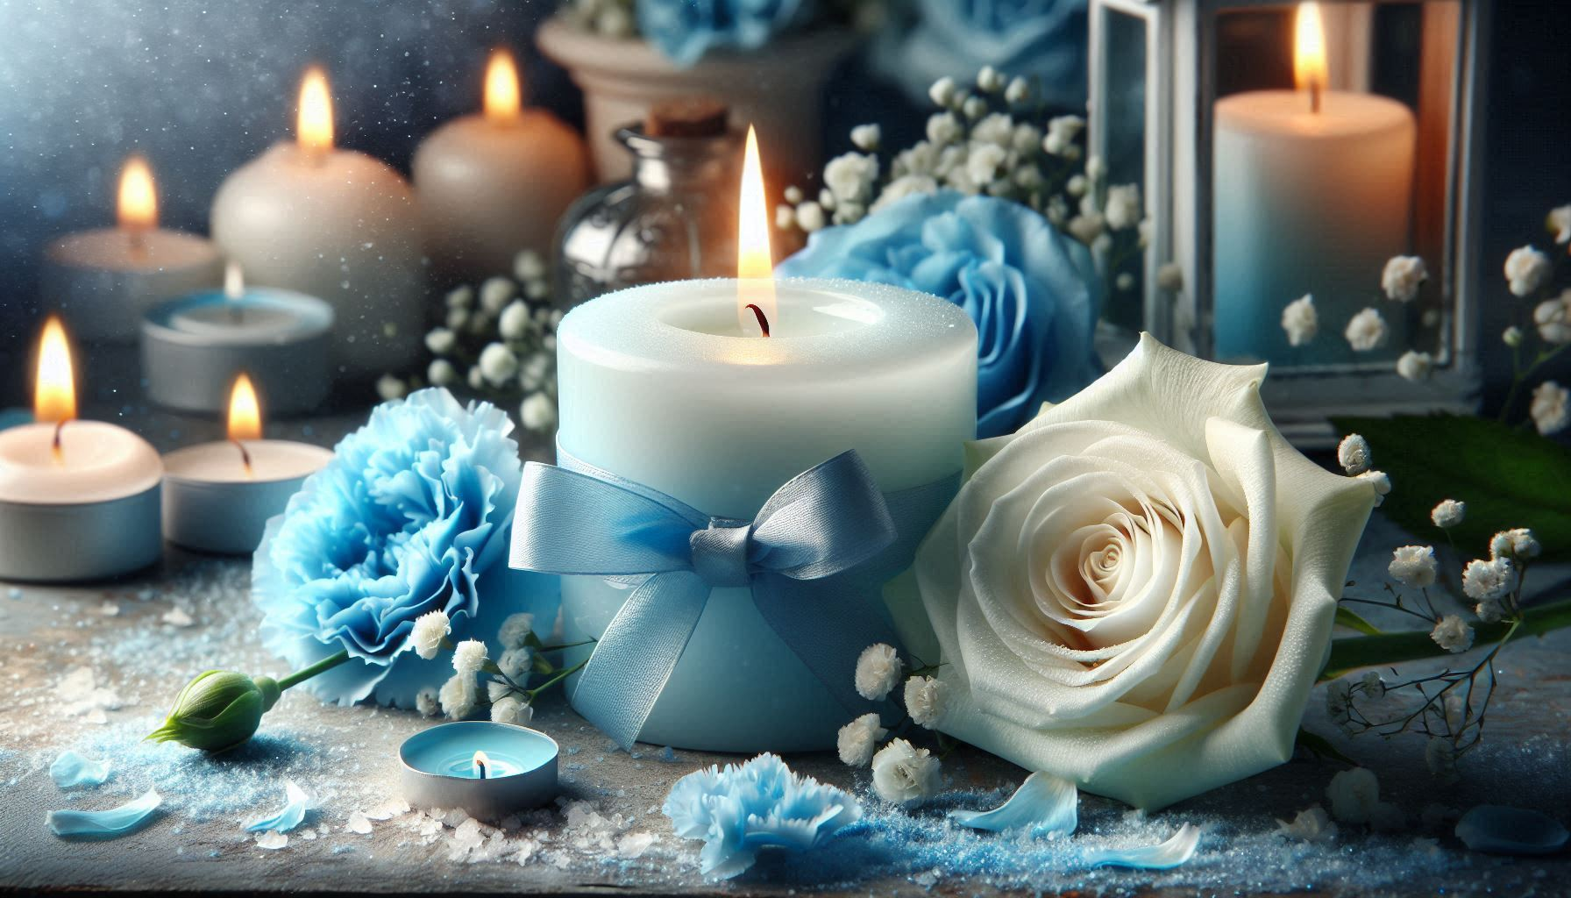
Tribute Ceremonies Include:
Nurses dress in traditional white uniform with white hosiery or socks, and white shoes.
Woman's uniform is completed wearing a cap and cape
and white gloves
Men may wear a navy-blue scrub top to match woman’s
cape
Nurse procession into the front of the church or funeral home with lit candles
Ttribute
There is placement of a white rose on the casket near the urn or presented to the family
The white rose exemplifies honor and appreciation to the nurse's devotion to their chose profession
A blue carnation on the casket or near the urn representing peace and serenity

Slide 7
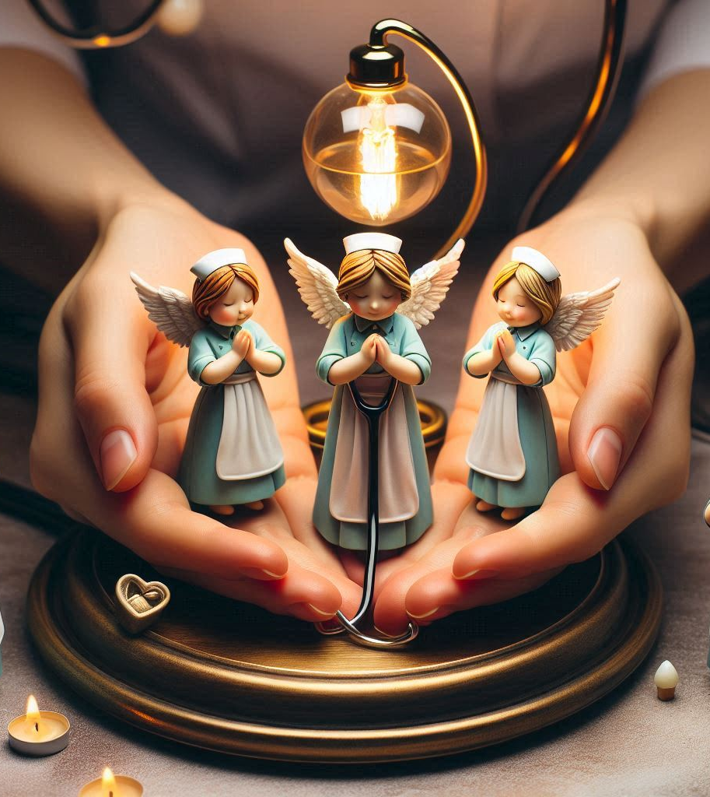
Tribute Ceremony Includes ContINUED
Presenting of the nightingale lantern to family
Last call
Nurses Prayer
Nurses will be seated or will process out of the church or funeral home will occur
***Nurse Honor Guard may be asked to be present at casket or participate as an honorary pallbearer by the family

Slide 8
Preparations
Cultural and spiritual diversities are discussed with family, funeral director and/or clergy prior to the service
Bio of nurse will be written and read at the family's request
Obtain picture of the nurse being honored for picture frame
Create assignments for nurses participating in honor ceremony-who is speaking, who carrying nightingale lantern, who will carry and ring chimes for last call, who will carry in and place the white rose and blue carnation on the casket, near urn or present to family

Slide 9
Other Services and Activities
Tributes to recognize and honor nurses in their last season of life and/or at the end of their life journey
Community outreach
Speaking engagements
Fundraising
Nurses supporting nurses

Slide 10
How the Honor Guard Services are Obtained
Funeral home, clergy or family will call or e-mail President and Founder of FLNHG to request services

Slide 11
What's Needed to Join the Finger Lakes Nurse Honor Guard?
Each member will follow the bi-laws of the organization as written and agreed up by its members
Purchase of white uniform in full and cape-cap and gloves are provided for women., men may wear a navy-blue scrub shirt to match the woman's cape
Commitment to at least 2 in person meetings per year for hands on practice of service
Attendance of 6 services a year is highly encouraged
35.00 annual dues

Slide 12
Questions and Answers

